Slide 1
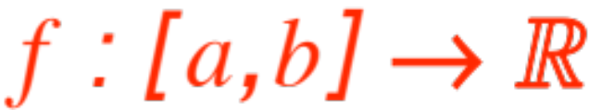
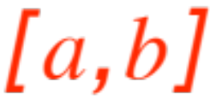
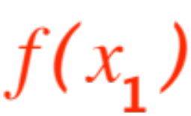
AVERAGING THINGS OUT
Suppose you have a given function
and your boss (instructor, departmental director) orders you to estimate an average value of the infinitely many values (one for every point in the interval ) of the function. How do you proceed?
If you are really pressed for time you take one value at random, cross your fingers and answer your boss with that number.

Slide 2
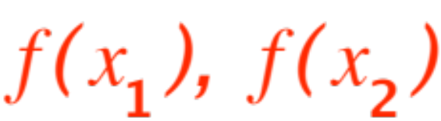
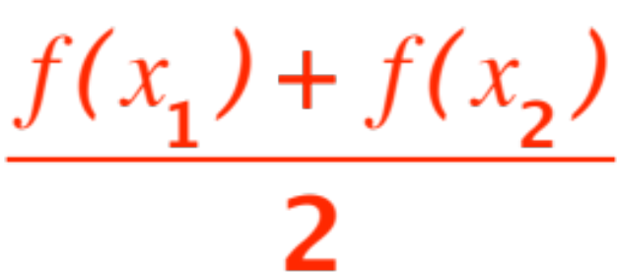
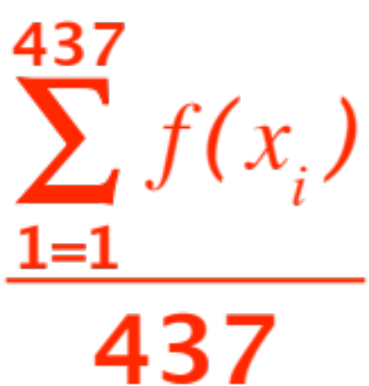
If you are a little more cautious you take two values of the function, average them out to get
and you give that answer to your boss.
If you are a nervous nellie you take 437 values of the function (maybe equidistant) and average them out to get
and that is your final answer.

Slide 3
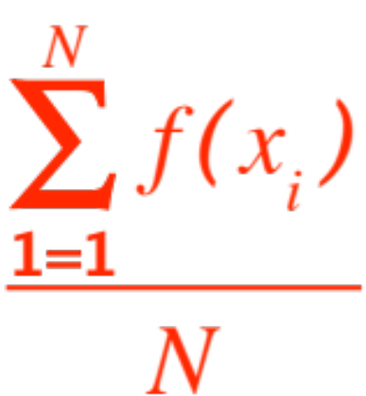


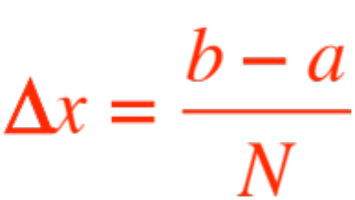
If you are a mathematician …
You ask yourself “what’s so special about 437 ?”
I will call it N and get an answer that looks like
This has the flavor of a Riemann sum, but it is not a Riemann sum. There is no !
But, if the points are equidistant, then each one of them is inside a little subinterval of length

Slide 4
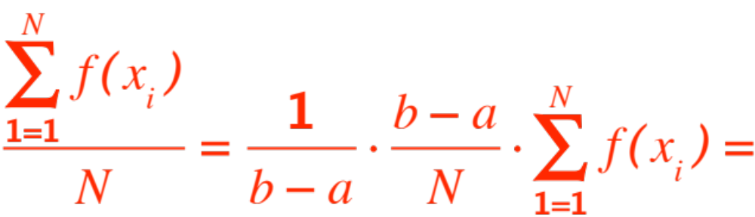
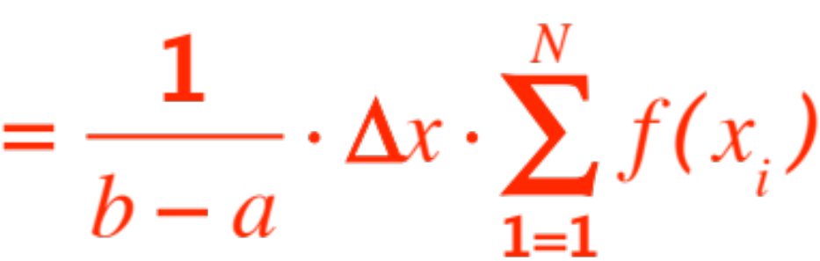
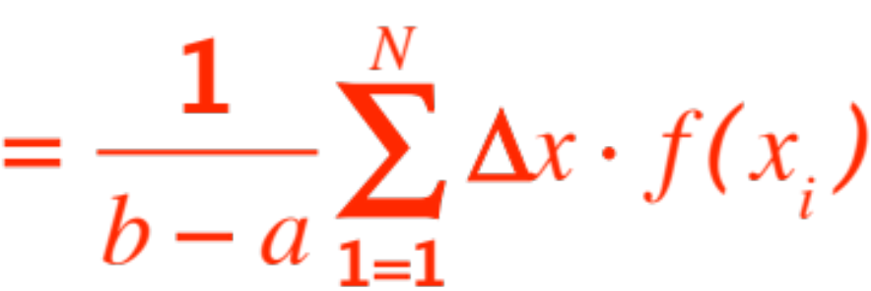

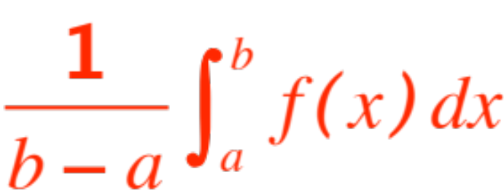
Aha! I can sneak a into the formula, this way:
This IS a Riemann sum, its limit as is
That is my final answer. In fact I will give the

Slide 5


Definition. Let be a Riemann integrable function. We call average value of the number
.
It seems that computing the average value of a function just boils down to computing its integral and dividing by the length of the interval over which we want the average to be.
(Note that, if the interval shrinks to the average value shrinks to one value of the function.)
If these were exam scores we are averaging

Slide 6
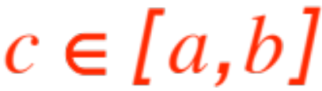
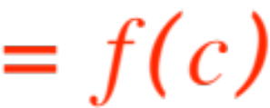
we would know that the average is somewhere between the lowest and highest scores but it need not be one of the scores.
For functions in general the same statement holds essentially true, but if is continuous we have more, we have the
(Mean Value Theorem for Integrals) Theorem.
Let be a continuous (and hence Riemann integrable) function. Then, for some point (maybe more than one)
! The proof:

Slide 7


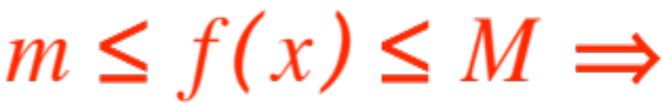
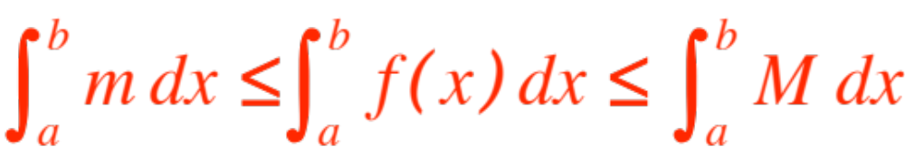

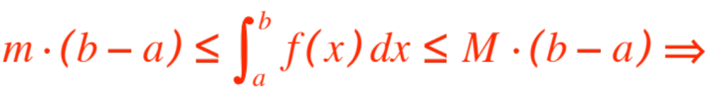
Applying the Extreme Value Theorem and standard properties (monotonicity) of Riemann integration we get:
Let and be the minimum and maximum respectively of over .
(They exist because of the EVT)

Slide 8
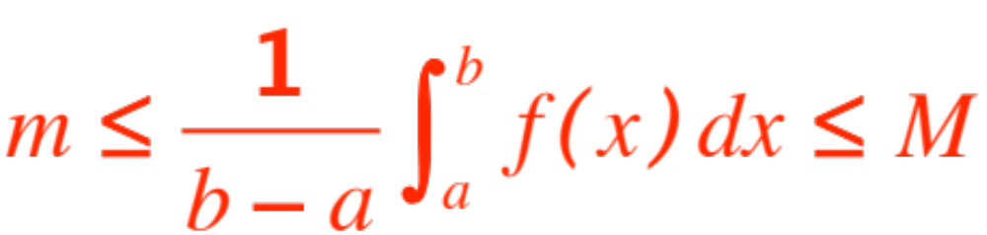


This means that the number
(we have called it the average value) is between the minimum and maximum values of the function.
By the Intermediate Value Theorem the function achieves that value somewhere between and .
QED
Just as with exam scores, the average is between the lowest and the highest, but unlike exam scores, it is achieved as a value ! (Maybe more that once.)

Slide 9
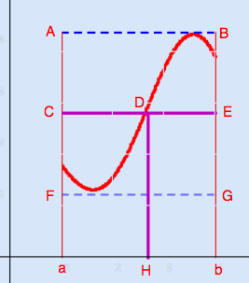
The figure is a clear pictorial representation of the meaning of the theorem.

Slide 10
One last remark: Why is it that with exam scores the average is almost never one of the scores, but in the case of continuous functions the average always is (at least) one of the values of the function?
The answer is that exam scores are usually just integers, numbers that do not distribute themselves in a continuum. The values of a continuous function, by definition, form a continuum.
In fact, even in the case of functions, if continuity does not hold our theorem does not follow. The figure in the next slide shows why:

Slide 11
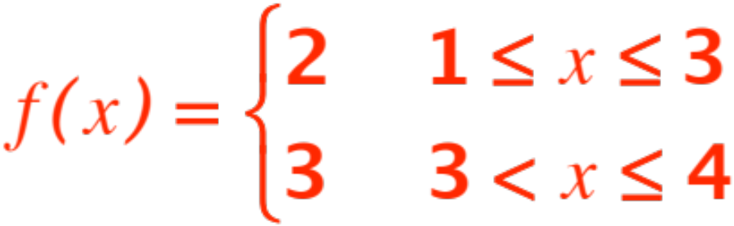
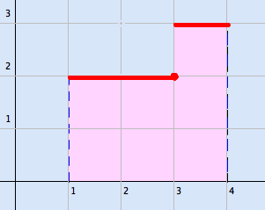


The function is:
The pink area is whence the average value of
, NOT a value of the function.

